Slide 1
Building Application In Android Lollipop
View Android Development course details at http://www.edureka.co/android-development-certification-course
For Queries:
Post on Twitter @edurekaIN: #askEdureka
Post on Facebook /edurekaIN
For more details please contact us:
US : 1800 275 9730 (toll free)
INDIA : +91 88808 62004
Email Us : sales@edureka.co

Slide 2
How it Works?

Slide 3
Objectives
At the end of this module, you will be able to:
Understand
Various Building Blocks of Android Application
Activity Lifecycle
App Monetization
Android Evolution
Create Android Application using Android 5.0 Lollipop

Slide 4
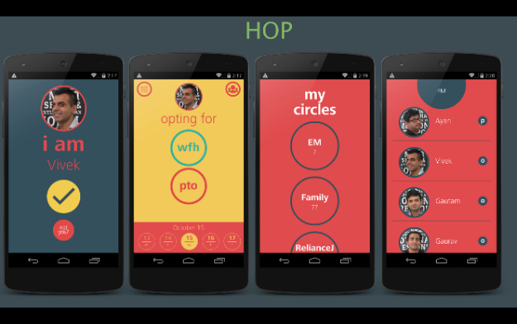
Application built using Android Lollipop sdk
Aryan
EM
??
Vivek
Gautam
Gaurav
Notes:
Can you identify this person?
Well, yes he is the guy who started it all. Android has got its name from him.
Now lets try to understand what this statement actually imply for all of us.

Slide 5
APIs used in HOP
Pallet API
Android 5.0 Animations
Android 5.0 Web Services
Android 5.0 Design guidelines and color schemes
Android 5.0 Transitions
Notes:
Can you identify this person?
Well, yes he is the guy who started it all. Android has got its name from him.
Now lets try to understand what this statement actually imply for all of us.

Slide 6
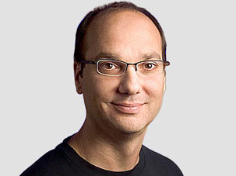
Did You Know?
“Every day more than 1 million new Android devices are activated worldwide.”
Andy Rubin,
Co-Founder Android Inc.,
SVP, Mobile and Digital Content,
Google Inc.
Notes:
Can you identify this person?
Well, yes he is the guy who started it all. Android has got its name from him.
Now lets try to understand what this statement actually imply for all of us.

Slide 7

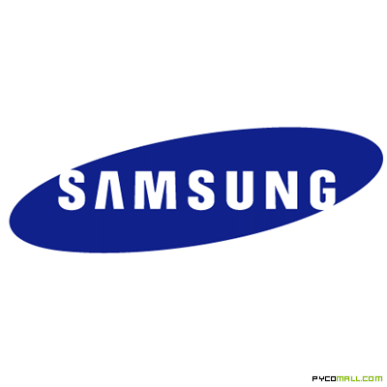











Android Ecosystem
OEMs
Consumers
App Dev Houses
Freelancers
Notes:
OK lets look at the Android ecosystem. We have the consumers( folks who buy the android devices and use the applications). Who are the other stakeholders in the Android Ecosystem.
Right, Google which develops Android. Then the OEMs original Equipment Manufacturers who manufacture the hardware and also the custom application components.
The biggest contributors to the ecosystem are the App Development companies ( who employ android developers). These companies also outsource the product dev work to services companies.
Then there are quite a few opportunities for Freelancers to create their apps and publish them google play store. The Freelancers can also work for one of the product companies and make good money.
Now, Almost 80% of the Apps are FREE so where do these companies get their revenues from?

Slide 8
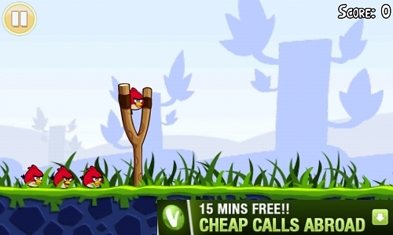
App Monetization
Notes:
Now this is a free android gaming app which is Angry Birds. The developers earned money from this free app by posting mobile adds on it. This is called app monetization. We have a complete chapter on App monetization and we will also tell you the best practices that should be followed.

Slide 9
Did You Know?
What are various Building Blocks of an Android App?
What is the Lifecycle of an Android App?
How does a Mobile App handle Hardware Events?
How does an App run Background Jobs like Network Download, Music Player etc.?
How do Multiple Apps Access Shared Resources such as Address Book, Photo Gallery etc.?
Notes:
1 min. Now we have all the question that you need to go through. You do not have to answer this right now

Slide 10
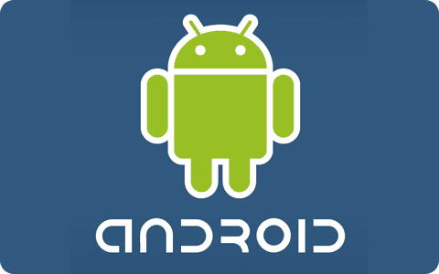

Introduction to Android
What is Android?
Open software platform
A complete stack – OS, Middleware, Applications
Fast application development using Java
Note: This course will deal with Native Android Application Development

Slide 11

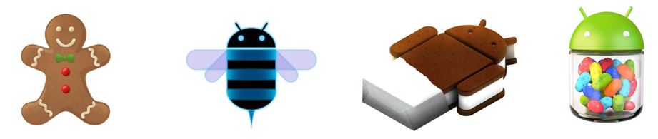
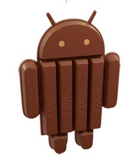
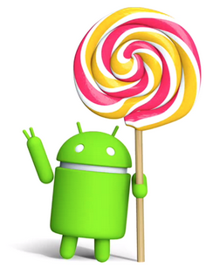
Android Evolution A-L…No B
??
1.5
Cupcake
1.6
Donut
2.0/2.1
Eclair
2.2
Froyo
2.3
Gingerbread
3.0/3.1
Honeycomb
4.0
Ice Cream Sandwich
4.1/4.2
Jelly Bean
4.4
KitKat
5.0
Lollipop
What
Next!!

Slide 12
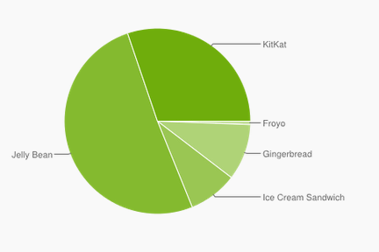
Android Evolution A-L…No B (Contd.)
The relative number of devices running a given version of the Android platform
Version | Codename | API | Distribution
2.2 | Froyo | 8 | 0.6%
2.3.3 - 2.3.7 | Gingerbread | 10 | 9.8%
4.0.3 - 4.0.4 | Ice Cream Sandwich | 15 | 8.5%
4.1.x | Jelly Bean | 16 | 22.8%
4.2.x |  | 17 | 20.8%
4.3 |  | 18 | 7.3%
4.4 | KitKat | 19 | 30.2%
KitKat
Froyo
Jelly Bean
Gingerbread
Ice Cream Sandwich
Ref: https://developer.android.com/about/dashboards/index.html

Slide 13
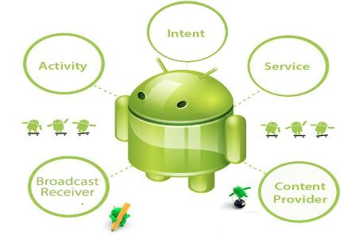



Main Building Blocks - Application
The components behind any Android App
Intent
Activity
Service
Broadcast Receiver
Content Provider
Notes:
We will learn about all the building blocks using the Facebook App as a base.

Slide 14
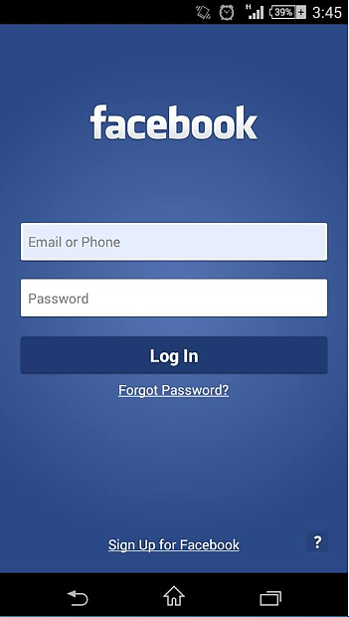
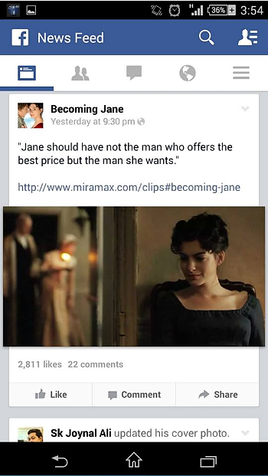
Activity - Typically a Screen
Login Activity
News Feed Activity
Notes:
Activity is a screen, Much like the pages in a website, each screen in an App is an activity. In the Facebook app shown here, the login screen is called the Login Activity.
After you login, the default activity you see is the news feed activity where you see the content from your friends and the pages you like.

Slide 15
Activity Lifecycle
Starting state
When an activity doesn’t exist in the memory, it is in a starting state
Running state
When an activity is currently on the screen and interacting with the user
Paused state
When an activity is not in focus (i.e., not interacting with the user) but still visible on the screen
Stopped state
When an activity is not visible, but still in the memory
Destroyed state
A destroyed activity is no longer in the memory
Starting
(1) OnCreate()
(2) onStart()
(3) On RestoreInstanceState()
(4) onResume()
Running
(3) onResume()
(2) onstart()
(1) onRestart()
(1) onSaveInstanceState()
(2) onPause()
onResume()
Stopped
(1) onSaveInstanceState()
(2) onStop()
Paused
onDestroy()
or
<process Killed>
<process killed>
Destroyed
Notes:
The activity in a running state is the one that is currently on the screen and interacting with the user..
When an activity is not in focus (i.e., not interacting with the user) but still visible on the screen, we say it’s in a paused state.
When an activity is not visible, but still in memory, we say it’s in a stopped state. .

Slide 16
Intents - Action
Think of Intents as a verb for an object
A description of what needs to be done
Example: VIEW, CALL, PLAY etc.
Notes:
System matches Intent with Activity that can best provide the service
Activities and IntentReceivers describe what Intents they can service

Slide 17
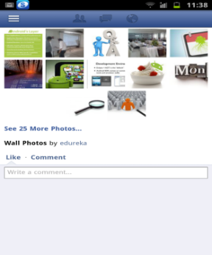
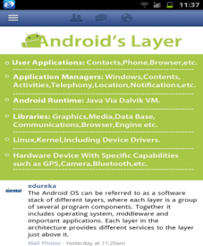
Intent - Switching Between Activities
View Photo Intent
Photo Gallery Activity
Photo View Activity
Notes:
In this example, while on the Photo Gallery Activity, if you want to view a particular photo, the click action on the photo thumbnail is the View Photo Intent and App loads the photon screen or the photo activity on the screen.

Slide 18
Services - Background Jobs
Faceless components running in background
They are of following types:
Unbound Service
It is a kind of service which runs in the background indefinitely, even if the activity which started this service ends
Bound Service
It is a kind of service which runs till the lifespan of the activity which started this service
Example: music player, network download etc.
Service Lifecycle
Starting
(1) onCreate()
(2) onStart()
Running
onDestroy()
or
<process killed>
Destroyed
Notes:
Services are background jobs which perform specific tasks. They are like activities without a UI. So, the states of Services are Start, Running and Destroyed. They run in background. An example could be the music player playing in background while you are looking at your news feed.
Draw an analogy between the states of activity and Services.
You can say that since a service doesn’t have a UI and always runs in the background it doesn’t have the Paused and stopped state.

Slide 19
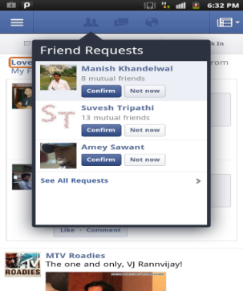
Services - Examples in Facebook App
Various Feeds by friends
Notifications about Friend Requests
Notes:
If we see our FB app, an example of background services is the news feed being updated and the notifications about friend requests.

Slide 20

Content Providers
Enables sharing of data across applications
Example: address book, photo gallery
Provide uniform APIs for:
Querying
Delete
Update
Insert
App
Content
Provider
insert()
update()
delete()
query()
Database
Notes:
Provide you abstraction from the underlying database.

Slide 21
Broadcast Receiver - Dormant Observer
Registers for Intents to Observe
Android System
Broadcast Receiver
Get Notification when Intents Occurs
Notes:
A broadcast receiver is a dormant component which comes into action only when some intent for which it has registered occurs.. Battery low notification, new friend notification, news feed , new message, call etc. are some intents which bring a broadcast receiver into action and it send appropriate notification to the user.

Slide 22
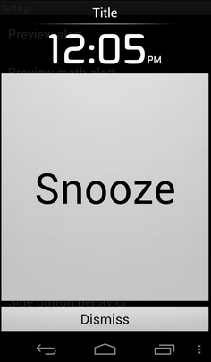
Broadcast Receiver - Dormant Observer
An alarm that wakes or rings the device when the stipulated time is reached, is triggered with the help of broadcast receiver
Registers for Intents to Observe
Broadcast Receiver
Get Notification when Intents Occurs
Similarly a notification of a change in the Time Zone is triggered with the help of broadcast receiver
Notes:
A broadcast receiver is a dormant component which comes into action only when some intent for which it has registered occurs.. Battery low notification, new friend notification, news feed , new message, call etc. are some intents which bring a broadcast receiver into action and it send appropriate notification to the user.

Slide 23
Recapture - Building Blocks
Activity – Screen
Wall, Login etc.
Intent – Action
Open Picture, Play YouTube Video
Service - Background Jobs
Music Player, Network Download, GPS
Content Provider – Fetch Data for Applications
Contacts, Photo Gallery
Broadcast Receivers – Dormant Observers
Message, Friend Request notification when App in Background
Notes:
ON this slide reiterate again on the examples of each component, You can say, Lets recapture what we have learnt till now. the Activity is a screen.. Intent is an Action.. Open picture, Play YouTube video. Service are background jobs.. Network download. Content providers Fetch data for applications .. Contacts , Photo Gallery ..
Broadcast Receivers are Dormant observers which come into action when something happens ..like a Friend req notification when the App is in Background.

Slide 24
Now, Do You Know?
What are the various Building Blocks of an Android App?
What is the Lifecycle of an Android App?
How does a Mobile App handle the Hardware Events?
How does an App run Background Jobs like Network Download, Music Player etc.?
How do Multiple Apps Access Shared Resources such as Address Book, Photo Gallery etc.?
Notes:
1 min

Slide 25
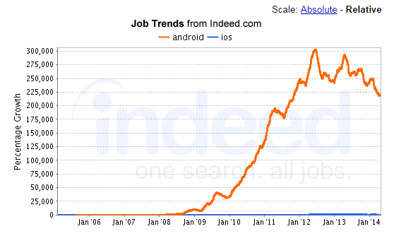
Job Trends
Source - http://www.indeed.com/jobtrends?q=android%2Cios&l=&relative=1
Notes:
1 min

Slide 26
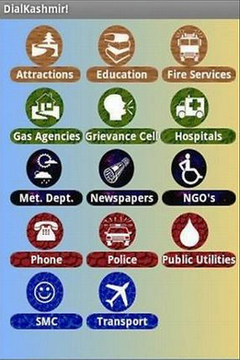
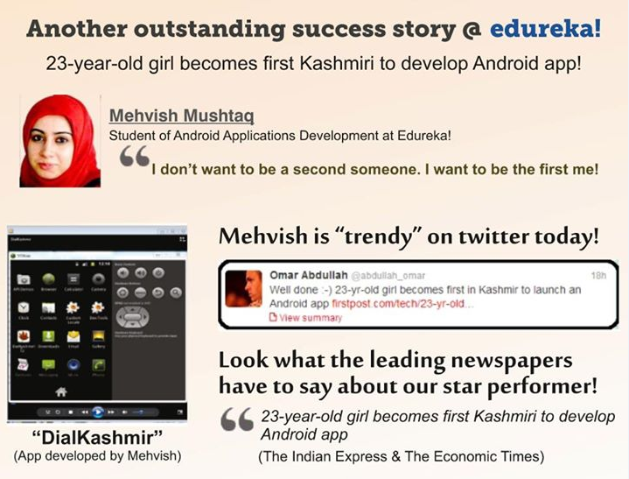
One of The Most Popular App
This is one of the most popular apps developed by an edureka student Mehvish Mushtaq

Slide 27
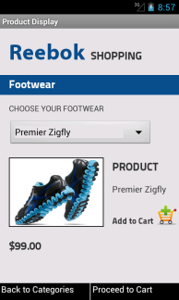
Few Apps Developed by Edureka Learner
PNR Enquiry App
Prashant Jain
Black Jack App
Hisham Muneer
Reebok Shopping App
Anubhav Gupta

Slide 28
Course Topics
Module 1
Java Essentials for Android
Module 2
Layout & Widgets
Module 3
Communication & Media
Module 4
Web Services
Module 5
Multi Activity Applications
Module 6
Database & Advanced Topics

Slide 29
How it Works?

